Slide 1
Intelligent Agents 2

Slide 2
The structure of Agents

Slide 3
Structure of an Intelligent Agent (1)
..till now we are talking about the agents behavior..
but how it works inside…?
The job of AI is to design the agent program: a function that implements the agent function mapping percepts to actions
Therefore we need architecture:
➢ where the program runs: computing device (HW+SW)
➢ with physical sensors and actuators
The architecture
➢ makes percepts available to program
➢ runs program
➢ feeds actions from program to actuators

Slide 4
Structure of an Intelligent Agent (2)
The relationship among all can be defined as…
agent = architecture + program
To design an agent program
    Possible percepts and actions
    What goals the agent is supposed to achieve
    What sort of environment it will operate in etc..
Example for architectures:
    might be an ordinary PC
    might be a robotic car with several onboard computers, cameras, and other sensors

Slide 5
Agent types
Four basic types in order of increasing generality:
  Table driven agent
  Simple reflex agents
  Model-based reflex agents
  Goal-based agents
    Problem solving agents
  Utility-based agents
    Can distinguish between different goals
  Learning agents

Slide 6
1. Table-lookup agent
function Table-Driven-Agent(percept) returns an action
static: percepts, a sequence // initially empty
table, a table of actions
// indexed by percept sequences,
// initially fully specified
append percept to the end of percepts
action <- LookUp (percepts, table)
return action

Slide 7
Implementing Agent program from Agent function
Agent function vs. Agent Program
The agent function takes the entire percept history.
The agent programs take the current percept as input from the sensors and return an action to the actuators.
  The agent program takes only the current percept as input because nothing more is available from the environment;
if the agent's actions need to depend on the entire percept sequence, the agent will have to remember the percepts.
Disadvantages?

Slide 8
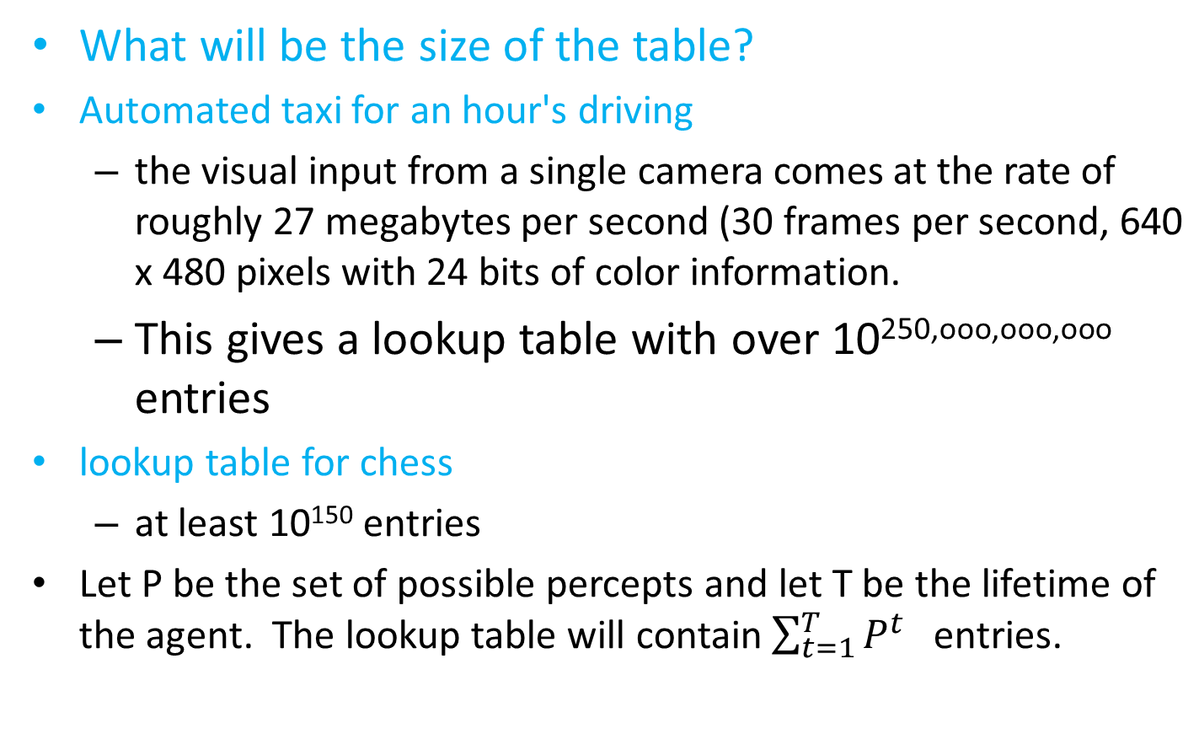
Table-lookup agent

Slide 9
Table-lookup agent
Drawbacks:
  Huge table
    no physical agent will have the space to store the table
    the designer would require long time to create the table
    Even with learning, need a long time to learn the table entries
    even if the environment yield a feasible table size, the designer still has no guidance about how to fill in the table entries.
  Not adaptive to changes in the environment;
    requires entire table to be updated if changes occur

Slide 10
Agent functions and programs
An agent is completely specified by the agent function mapping percept sequences to actions
Aim: find a way to implement the rational agent function concisely
Key challenge in AI is to produce rational behavior from a small code rather than from a table with large entries
This has been done successfully
  Ex 1: Square root table used prior to 1970s has been replaced by Newton’s 5 line code in computers
  Ex2: Vacuum agent program is very small compared to its table (shown later)

Slide 11
2. Simple reflex agents
Select action on the basis of only the current percept (ignores the percept history).
  E.g. the vacuum-agent
  Its action is based only on the current location and its status
Implemented through condition-action rules
  If clean then left

Slide 12

Simple reflex agents
Rectangles to represent current internal state
Ovals to represent background information

Slide 13
Building agent program
The vacuum agent program (GIVEN NEXT) is very small compared to the table
1) The reduction comes from ignoring the percept history
  So, the no of possibilities are reduced to 4 from 4^{T}.
2) Another reduction comes from the fact that when the current square is dirty, the action does not depend on location

Slide 14

The vacuum-cleaner world :Agent program for a simple reflex agent
function REFLEX-VACUUM-AGENT ([location, status]) return an action
if status == Dirty then return Suck
else if location == A then return Right
else if location == B then return Left

Slide 15
Simple reflex agents
Uses condition-action rules. In humans, condition-action rules are both learned responses and innate reflexes (e.g., blinking).
➢ if light-is-green then accelerate
➢ if light-is-red then brake
A condition-action rule
  If (condition) then (do a specific action)
Sequence lookup of condition-action pairs defining all possible condition-action rules necessary to interact in an environment
  e.g. if car-in-front-is-breaking then initiate breaking (in automatic cars)
Correct decisions made solely based on current percept.

Slide 16
Simple reflex agent
function SIMPLE-REFLEX-AGENT(percept) returns an action
static: rules, a set of condition-action rules
state ← INTERPRET-INPUT(percept)
rule ← RULE-MATCH(state, rule)
action ← RULE-ACTION[rule]
return action
Interpret-Input: generates an abstracted description of the current state from the percept
A simple reflex agent works by
finding a rule whose condition matches the current situation (as defined by the percept) and
then doing the action associated with that rule.

Slide 17
Simple reflex agent - Limitations
  Will work only if the correct decision can be made on the basis of only the current percept
      possible only if the environment is fully observable
  Limited intelligence
  Example1
  if car-in-front-is-braking then initiate braking (in automatic cars)
    The braking rule assumes that the condition can be determined from the current percept which is the current video image
    It is not always possible to tell from a single image whether the car is braking (especially when there other lights and not a centrally mounted brake light)
    A simple reflex agent driving behind such a car might brake continuously - unnecessary or not at all

Slide 18
Simple reflex agent - Limitations
  Example2
    Assume the simple reflex agent does not have its location sensor working properly and has only a dirt sensor
    Then, it has only 2 possible percepts : [dirty] and [clean]
    It can suck for [dirty]
    But, what about [clean]?
    Moving left fails if it is already in A
    Moving right fails if it is already in B
  So, infinite loops may occur in partially observable environments.
  Randomized action can escape from infinite loops
    It is easy to show that the agent will reach the other square in an average of two steps
    So a randomized simple reflex agent might perform better than a deterministic simple reflex agent
    However, we can do better by employing more sophisticated deterministic agents (next slides)

Slide 19
3. Model-based reflex agents
So when we can’t see something, we model it!
  Create an internal variable to store the expectation of variables we can’t observe
Models are very important!
  We all use models to get through our lives
    Psychologists have many names for these context-sensitive models
  Agents need models too

Slide 20
Model-based reflex agents
The most effective way to handle partial observability is
  for the agent to keep track of the part of the world which cannot be seen now
So, the agent should maintain some sort of internal state that depends on the percept history
  This enables some of the unobserved aspects of the current state

Slide 21
Model-based reflex agents
Example 1
For the braking problem, the internal state is just the previous frame from the camera
This allows the agent to detect multiple lights go on or off simultaneously
Example 2
For changing lane problem, the agent needs to keep track of where the other cars are if it cannot see all at once (to avoid collisions)

Slide 22

Model-based reflex agents

Slide 23
Model-based reflex agents
Updating the internal state information requires two kinds of knowledge to be encoded into the agent program
  1. Information about how the world evolves (independent of the agents’ actions)
  Ex1:
  An overtaking car generally will be closer behind than it was a moment ago
  2. Information about how the agents’ own actions affect the world
  Ex1:
  When the agent turn the steering wheel clockwise, the car turns to the right
This knowledge about “how the world works” is called a model of the world
An agent that uses such a model is called a model-based agent

Slide 24
Model-based reflex agents
The structure of model based agent
Internal state –
  showing how the current percept is combined with the old internal state to generate the updated description of the current state
The function UPDATE-STATE achieves this
  Creating new internal state description
  Interpreting the new percept in the light of existing knowledge about the state
  Keeping track of unseen part of the world by using information about how the world evolves
  To Know about what the agent’s actions do to the state of the world

Slide 25
Model-based reflex agents vs. Simple reflex agent
Function REFLEX-AGENT-WITH-STATE(percept) returns an action
static: state, a description of the current world state
rules, a set of condition-action rules
action, the most recent action, initially none
state ← UPDATE-STATE(state, action, percept)
rule ← RULE-MATCH(state, rules)
action ← RULE-ACTION[rule]
return action
function SIMPLE-REFLEX-AGENT(percept) returns an action
static: rules, a set of condition-action rules
state ← INTERPRET-INPUT(percept)
rule ← RULE-MATCH(state, rule)
action ← RULE-ACTION[rule]
return action
Note: The details of how models and states are represented vary on the type of environment and the particular technology used in the agent design.
Detailed examples of models and updating algorithms appear in Chapters 4, 12, 1 1 , 15, 17, and 25

Slide 26
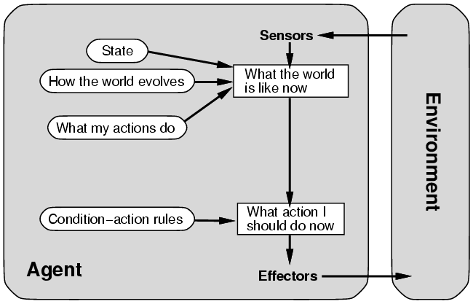
Agents that Keep Track of the World
function Reflex-Agent-With-State(percept) returns action
static: rules, a set of condition-action rules
state, a description of the current world
action, the most recent action, initially none
state ← Update-State(state, action, percept)
rule ← Rule-Match(state, rules)
action ← Rule-Action[rule]
return action
Notes:
LEARNING IN INTELLIGENT AGENTS
With the reflex architecture, if the table of rules prescribes the
wrong action, and the agent discovers this and changes the table,
it has automatically generalized from its specific experience.
Generalization is a key phenomenon in learning. Generalization
always requires previous "background" knowledge to direct it.
All complex intelligent agents will have a lot of background knowledge
preprogrammed, because they do not have the time to receive enough
experience and feedback from the environment to allow them to learn to
behave correctly starting from scratch.
In linguistics this is called the "poverty of stimulus" argument. If
you calculate how many sentences a young child hears before it starts
to speak correct English, the number is too few to allow it to "guess"
the grammar of English. Therefore the baby must have a so-called
universal natural language grammar preprogrammed into it by its genes.
This argument is controversial, but there is scientific agreement
that background knowledge of some sort (often very hidden and implicit)
is necessary for learning in humans and AI systems.

Slide 27
Model-based reflex agents- issues
it is seldom possible for the agent to determine the current state of a partially observable environment exactly.
Instead, the box labeled "what the world is like now" represents the agent's "best guess"
  Ex: an automated taxi may not be able to see around the large truck that has stopped in front of it
  it can only guess about what may be causing the hold-up.
Thus, uncertainty about the current state may be unavoidable, but the agent still has to make a decision.

Slide 28
4. Goal-based agents
Knowing current state is not always enough to decide what to do.
Example:
(1) Decision to change lanes depends on a goal to go somewhere (for a taxi driver at a road junction to turn left, right or straight);
(2) shopping will depends on a shopping list, map of store, knowledge of menu
Reflex agent: wander around the shop and grab items.
Goal-based agent: shopping list.

Slide 29
Agents with Explicit Goals
Knowing current state is not always enough.
  Along with a current state description, the agent needs some sorts of goal information
  Goal information describes situations that are desirable
  Goal = description of desired situation
The agent program can combine goal information with information about the results of possible actions (same information that was used to update internal state in the model based reflex agent)
Notes:
  Search (Russell Chapters 3-5) and Planning (Chapters 11-13) are concerned with finding sequences of actions to satisfy a goal.

Slide 30

Goal-based agent structure
Keeps track of the state as well as a set of goals to choose an action that will eventually lead to achievement of goals

Slide 31
Agents with Explicit Goals
Reasoning about actions
  reflex agents only act based on pre-computed knowledge (rules)
  goal-based (planning) act by reasoning about which actions achieve the goal

Slide 32
Goal-based agents VS. Simple Reflex
Contrast decision making of goal based agents with condition-action rules of reflexive agents:
In the goal based agent design
  involves consideration of future "what will happen if I do ..."
    less efficient, but more flexible and possible to change
    Flexible because the knowledge that supports its decisions is explicitly represented and can be modified
    If it starts to rain, the agent can update its knowledge on how effectively brakes will operate
    This will cause all the existing behavior to be altered to suit new conditions
    The behavior can easily be changed to go to a different location (ie., different goal)

Slide 33
Goal-based agents VS. Simple Reflex
Contrast decision making of goal based agents with condition-action rules of reflexive agents:
In the reflex agent designs,
  information is not explicitly represented since built-in rules map directly from percepts to actions
  It requires rewriting many condition-action rules to suit the new conditions
  The behavior cannot be easily be changed to go to a different location. It requires replacing all the rules to go to a new location
Example
The reflex agent brakes when it sees brake lights
A goal based agent could reason that if the brake light is on, it will slow down

Slide 34
Goal-based agents
Goal-based action selection is straightforward
Ex: goal results immediately from a single action.
Sometimes it will be more tricky
Ex: when the agent has to consider long sequences of twists and turns in order to find a way to achieve the goal.
Note: Search (Chapters 3 to 5) and planning (Chapters 10 and 11) are the subfields of AI devoted to finding action sequences that achieve the agent's goals.

Slide 35
5. Utility-Based Agents
Goals alone are not enough to generate high-quality behavior in most environments.
  Ex: many action sequences will get the taxi to its destination (thereby achieving the goal)
  but some are quicker, safer, more reliable, or cheaper than others
Preferred world state has higher utility for agent = quality of being useful
Examples
  quicker, safer, more reliable ways to get where going;
  price comparison shopping
  bidding on items in an auction
  evaluating bids in an auction
Utility function: state ==> U(state) = measure of happiness is called utility
Search (goal-based) vs. games (utilities).

Slide 36
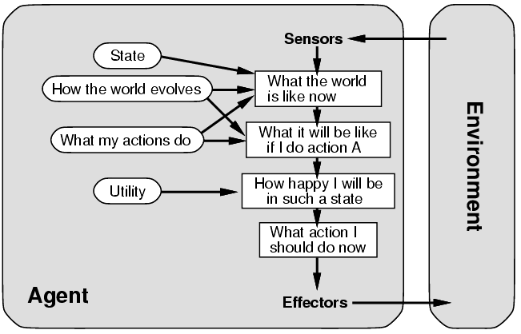
A Complete Utility-Based Agent
Utility Function vs. goal based agent
  allows rational decisions(improve) in two kinds of situations
    evaluation of the tradeoffs among conflicting goals
    evaluation of competing goals (based on likely hood of success )

Slide 37
Utility-based agents
When there are multiple possible alternatives, how to decide which one is best?
A goal specifies a crude destination between a happy and unhappy state, but often need a more general performance measure that describes “degree of happiness” known as utility
Allows decisions comparing choice between conflicting goals, and choice between likelihood of success and importance of goal (if achievement is uncertain)
An agent that possess an explicit utility can make rational decisions.

Slide 38

Utility-based agents
Certain goals can be reached in different ways.
  Some are better, have a higher utility.
Utility function maps a (sequence of) state(s) onto a real number.

Slide 39
Utility-based agents
A model-based, utility-based agent.
uses a model of the world, along with a utility function
Utility function measures its preferences among states of the world.
Then it chooses the action that leads to the best expected utility
expected utility is computed by averaging over all possible outcome states, weighted by the probability of the outcome

Slide 40
Utility-based agents
A performance measure assigns a score to any given sequence of environment states
  so it can easily distinguish between more and Jess desirable ways of getting to the taxi's destination.
An agent's utility function is essentially an internalization of the performance measure.
If the internal utility function and the external performance measure are in agreement, then an agent that chooses actions to maximize its utility will be rational according to the external performance measure

Slide 41
Utility-based agents - issues
a rational utility-based agent
chooses the action that maximizes the expected utility of the action outcomes
Means that the utility the agent expects to derive, on average, given the probabilities and utilities of each outcome
Note: Partial observability and stochasticity are ubiquitous in the real world
Utility-based agent programs appear in Part IV, where decision-making agents are designed to handle the uncertainty inherent in stochastic or partially observable environments.

Slide 42
Utility-based agents - issues
To build intelligent agents, build agents that maximize expected utility
Complexities due to
  A utility-based agent has to model and keep track of its environment
  tasks involving research on perception, representation, reasoning, and learning
  Choosing the utility-maximizing course of action is also a difficult task
  requiring ingenious algorithms
  Even with these algorithms, perfect rationality is usually unachievable in practice because of computational complexity

Slide 43
Shopping Example Activities
Goal based vs. utility based agents
Menu-planning. Generate shopping list, modify list if store is out of some item.
➢ Goal-based agent: required; what happens when a needed item is not there? Achieve the goal some other way. e.g., no milk packs: get canned milk or powdered milk.
Choosing among alternative brands
➢ utility-based agent: trade off quality for price.

Slide 44

6. Learning agents
All previous agent-programs describe methods for selecting actions.
  Yet it does not explain the origin of these programs.
  Learning mechanisms can be used to perform this task of building learning machines or learning systems.
  Teach them instead of instructing them.
  Advantage is the robustness of the program toward initially unknown environments than based on initial knowledge alone.

Slide 45
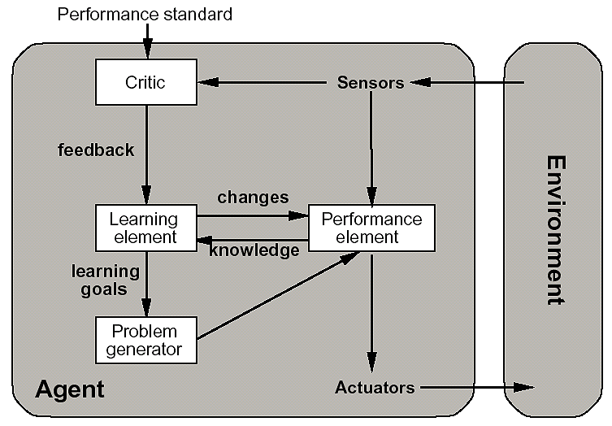
Learning Agents
The performance element is what we previously considered to be the entire agent:
it takes in percepts and decides on actions

Slide 46
Learning Agents
Four main components:
  Performance element: responsible for selecting external elements (the agent function)
    It takes in percepts and decides an actions.
  Learning element: responsible for making improvements by observing performance
    Takes feedback from critic on agents performance
    Determines how the performance element can be modified to do work better
  Critic: gives feedback to learning element by measuring agent’s performance
    Tells the learning element how well agent is doing?
    It is necessary because percept themselves provide no indication of agent’s success
  Problem generator: suggest other possible courses of actions (exploration) that will lead to new and informative experience
    Also responsible for exploring more and suboptimal actions in short run and suggest these exploratory actions.

Slide 47
Learning Agents
Performance element vs. Learning element
The design of the learning element depends very much on the design of the performance element.
When trying to design an agent that learns a certain capability
  the first question is not "How am I going to get it to learn this?"
  but "What kind of performance element will my agent need to do this once it has learned how?"

Slide 48
Learning Agents
Performance Element
  Selecting actions
Critic
  Provides learning element with feedback about progress
Learning Element
  Making improvements
Problem Generator
  Provides suggestions for new tasks to explore state space

Slide 49
A taxi driver
Performance Element
  Knowledge of how to drive in traffic
Critic
  Observes tips from customers and horn honking from other cars
Learning Element
  Relates low tips to actions that may be the cause
- able to formulate a rule saying this was a bad action, and the performance element is modified by installation of the new rule.
Problem Generator
  Proposes new routes to try and improve driving skills
- Identify certain areas of behavior in need of improvement and suggest experiments, such as trying out the brakes on different road surfaces under different conditions (ex: scientists trying out new experiments)

Slide 50
Learning Agents in earlier agent designs
The learning element can make changes to any of the "knowledge" components shown in earlier agent diagrams
In reflex agents
The simplest cases involve learning directly from the percept sequence.
Observation of pairs of successive states of the environment can allow the agent to learn "How the world evolves” and
observation of the results of its actions can allow the agent to learn "What my actions do."

Slide 51
Learning Agents in earlier agent designs
The learning element can make changes to any of the "knowledge" components shown in earlier agent diagrams
In utility-based agent that wishes to learn utility information
Ex: suppose the taxi-driving agent receives no tips from passengers due to bad driving
The external performance measure must inform the agent that the loss of tips is a negative contribution to its overall performance
Now the agent might be able to learn
The performance measure distinguishes part of the incoming percept as a reward (or penalty) that provides direct feedback on the quality of the agent's behavior.

Slide 52
Learning Agents in earlier agent designs
Agents have a variety of components
components can be represented in many ways within the agent program
so there appears variety among learning methods
However, learning in intelligent agents can be summarized as
a process of modification of each component of the agent to bring the components into closer agreement with the available feedback information, thereby improving the overall performance of the agent.

Slide 53
Summary: Intelligent Agents
An agent perceives and acts in an environment, has an architecture, and is implemented by an agent program.
Task environment – PEAS (Performance, Environment, Actuators, Sensors)
The most challenging environments are inaccessible, nondeterministic, dynamic, and continuous.
An ideal agent always chooses the action which maximizes its expected performance, given its percept sequence so far.
An agent program maps from percept to action and updates internal state.
  Reflex agents respond immediately to percepts.
    simple reflex agents
    model-based reflex agents
  Goal-based agents act in order to achieve their goal(s).
  Utility-based agents maximize their own utility function.
All agents can improve their performance through learning.

Slide 54


